Slide 1



GOA POLICE
HACKATHON 2024
AI-BASED TOOL TO ASSIST
VISITORS AT
POLICE STATIONS
Neural Ninjas

Slide 2
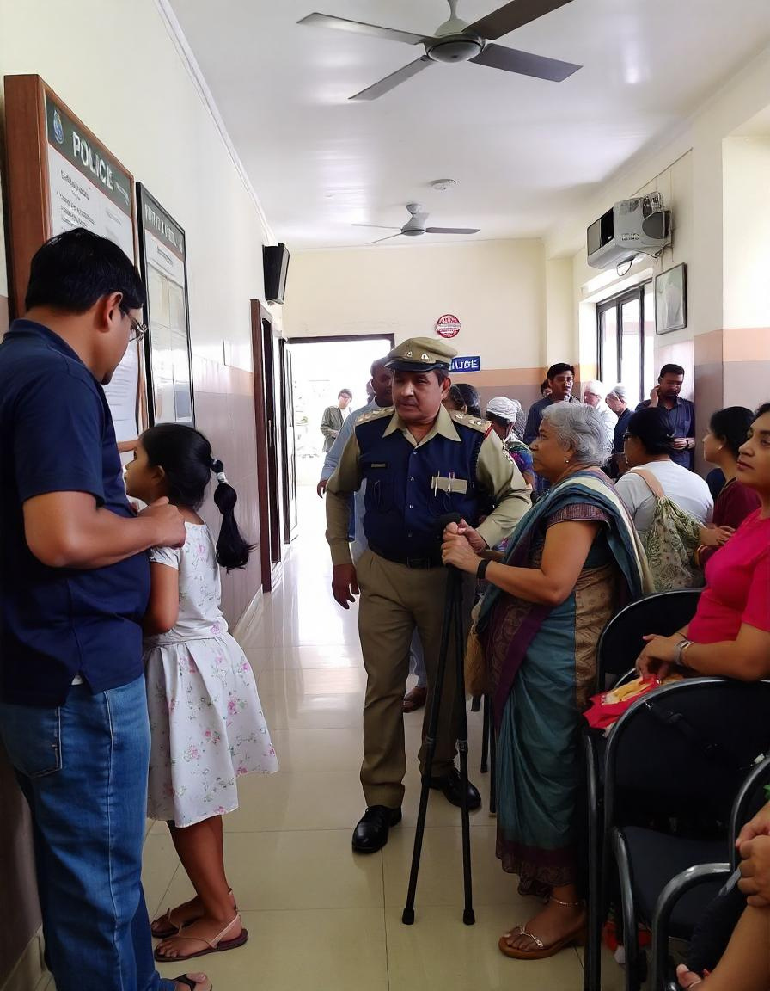
Introduction
Language Barriers: Difficulty in communication due to lack of multilingual support for non-native speakers.
Complex Legal Procedures: Lack of understanding of legal processes, leading to confusion and delays in filing reports.
Frequent Queries: Overwhelming police personnel with repetitive questions about common legal concerns.
Limited Access to Information: Difficulty accessing basic legal information without prior knowledge or in-person visits.
Manual Assistance: Dependence on police staff for guidance, causing delays and inefficiencies.
Documentation Confusion: Unclear requirements for filing complaints and obtaining legal documents.

Slide 3

Proposed Solution
Objective: To develop an advanced NLP-driven voice activated chatbot that streamlines access to legal information.
Multilingual Accessibility: Facilitates seamless interaction across diverse languages.
Case Filing & Documentation: Streamlines the process of case initiation and automates document generation.
Navigating Legal Procedures: Provides comprehensive guidance through intricate legal frameworks, including the steps involved in police case registration.
Addressing Common Inquiries: Expedites the resolution of frequently encountered legal queries.
Cost-Efficiency: Significantly reduces the necessity for physical consultations, conserving both time and resources.

Slide 4
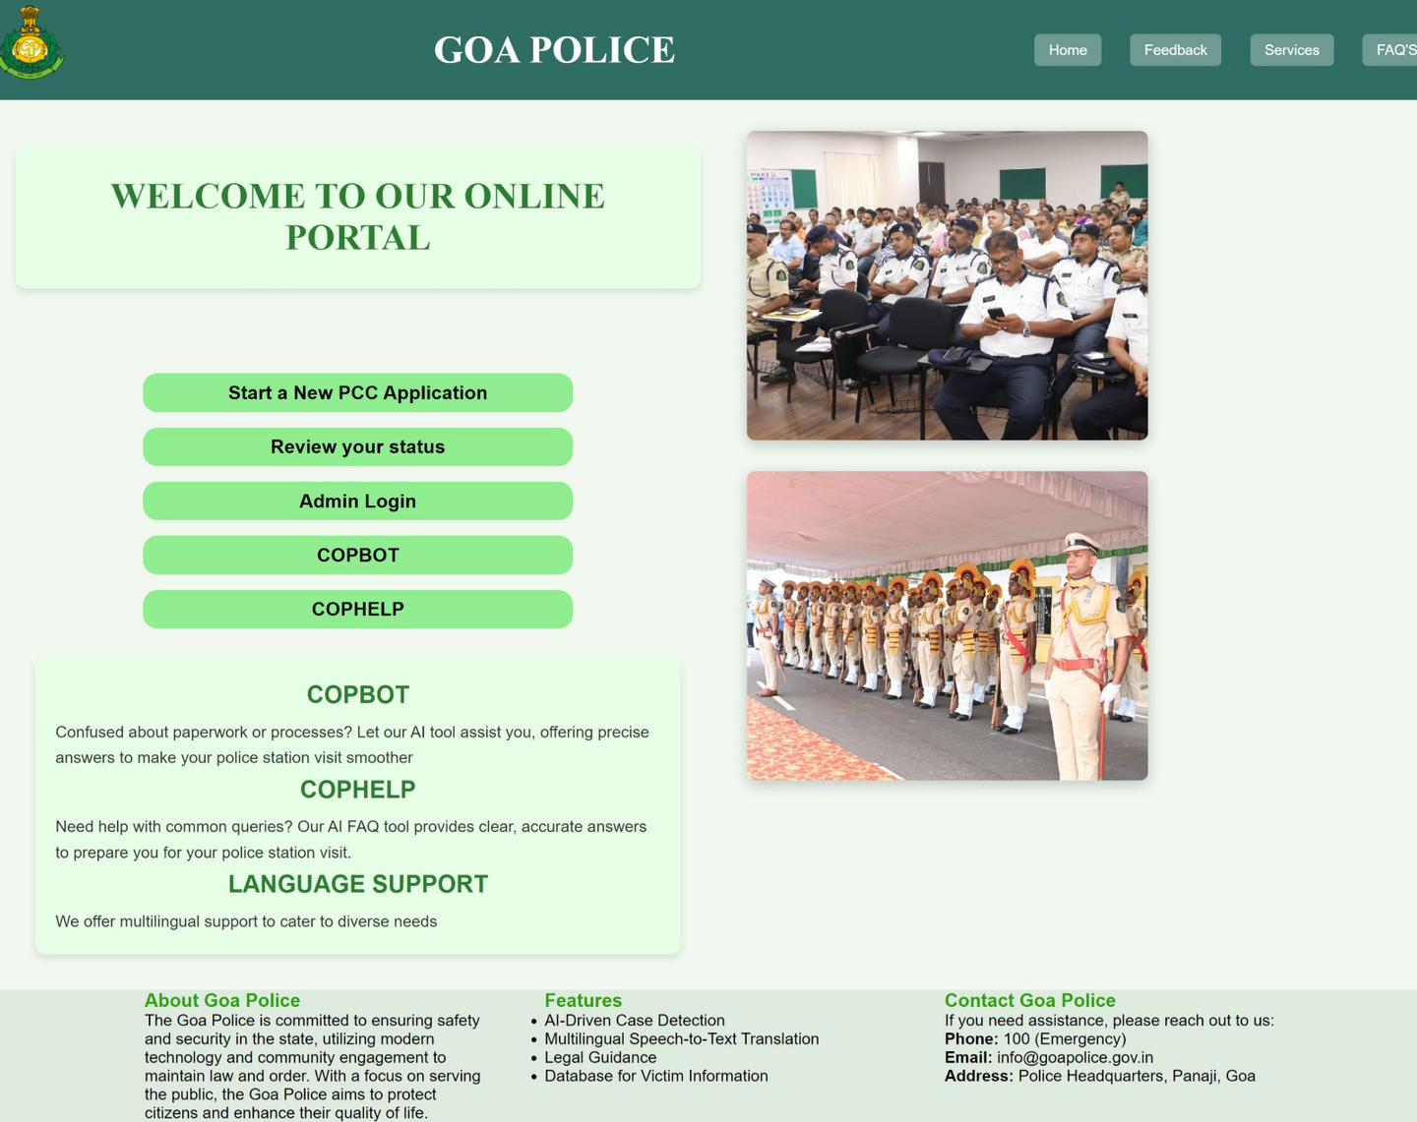


It allows users to begin the process of applying for a Police Clearance Certificate (PCC) by guiding them through the necessary steps and documentation required for the application.
It enables visitors to check the current status of their PCC application by entering their application details, providing real-time updates on the progress of their request.
It allows administrators to securely log in to the system and update the live status of PCC applications for users.
It is a chatbot allowing users to speak their issue in their preferred language. It identifies the type of case and guides them through the legal procedures to follow.
It is a chatbot enabling users to ask general legal queries and receive informative responses to their questions.
Other Features

Slide 5

COPBOT
Empowering Justice Through Intelligent Conversation
NLP-Based Chatbot: Developed using Hugging Face technologies.
Extensive Dataset: Compiled a large dataset covering various case types and their legal procedures.
User-Friendly: Simplifies the process for visitors, making it easier to understand legal matters.
Efficiency: Accelerates visitor interactions, leading to quicker resolutions of queries.
Support for Police Officers: Eases their workload by automating responses to common legal inquiries.
Enhanced Productivity: Allows police officers to focus on more complex cases, improving overall efficiency.

Slide 6
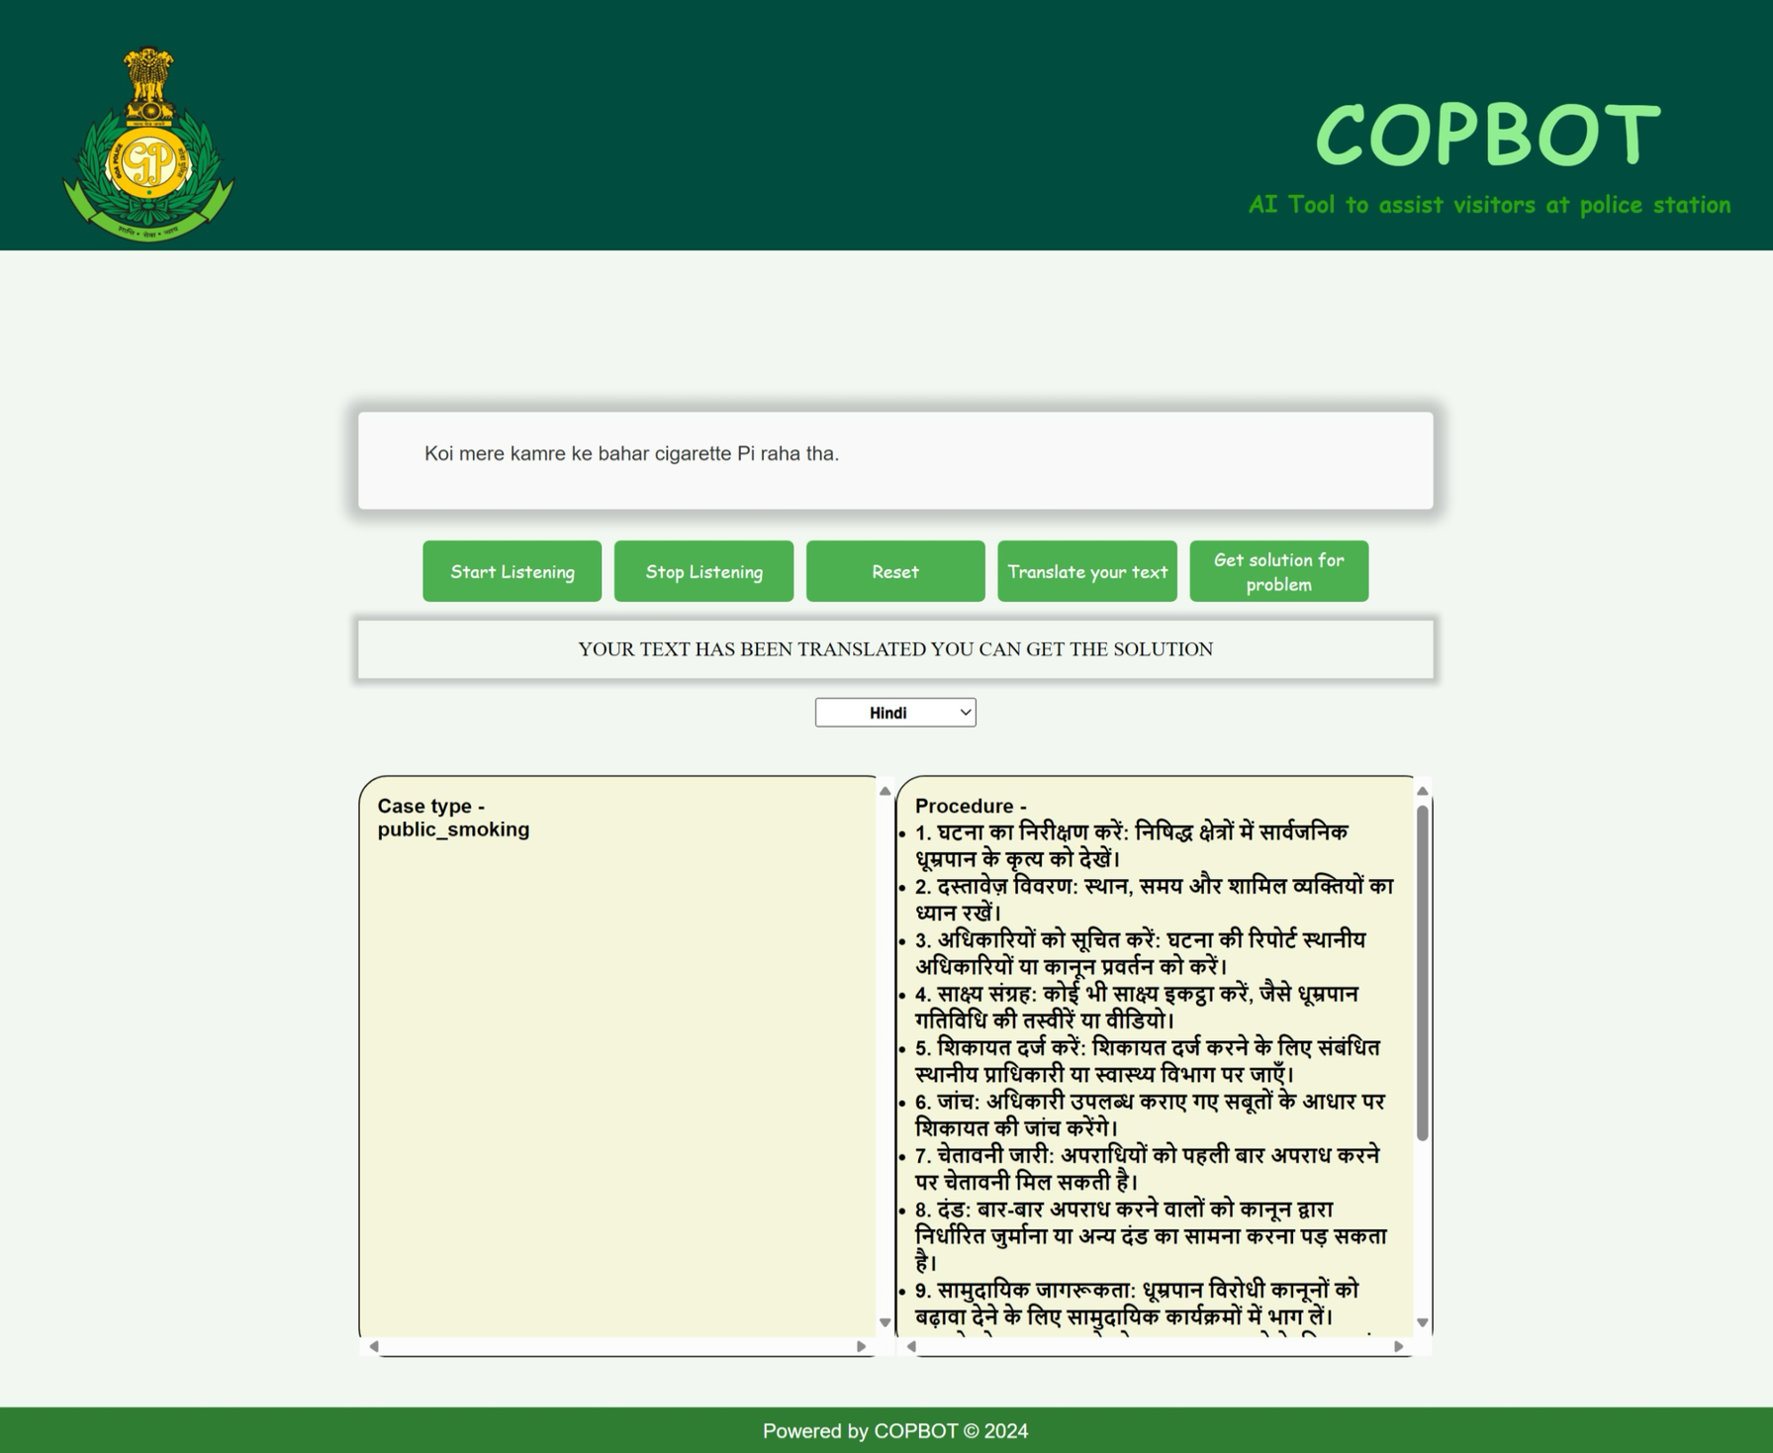
Start Listening: Click to begin recording your issue.
Stop Listening: Click to stop the recording process.
Reset: Click to clear the text box and start fresh.
Translate Your Text: Click to convert your preferred language to English.
Get Solution for Problem: Click to find out the legal procedures to follow for your issue.
This text box displays the user's spoken input after clicking the "Start Listening" button, providing a clear, written record of their issue for easy reference and understanding.
It displays a message indicating that your text has been successfully translated, confirming the completion of the translation process.
1
2
3
4
This dropdown allows visitors to select their preferred language for receiving legal procedures, ensuring a personalized and accessible experience.
This text box displays the type of case that corresponds to the visitor's issue, offering clear identification of the legal matter at hand.
This text box instantly provides visitors with the legal procedures to follow after identifying the case type, offering clear and actionable guidance tailored to their specific situation.

Slide 7
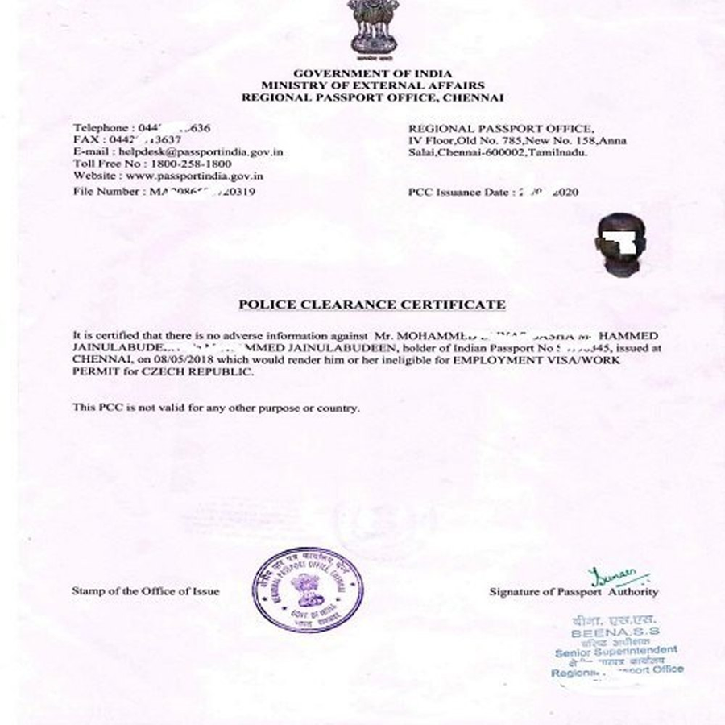
Police Clearing Certificate
MERN Stack Development: Built using the MERN stack for a robust and scalable application.
Online Application Process: Transitions the PCC application process online, reducing the need for in-person visits.
Reduced Tension: Alleviates stress between applicants and police officers by streamlining communication and processes.
User-Friendly Interface: Provides an intuitive platform for applicants to submit their information easily.
Real-Time Status Updates: Enables applicants to track their application status instantly, improving transparency.
Efficiency for Officers: Simplifies the verification and processing of applications, allowing officers to manage workloads more effectively.
Enhanced Experience: Improves the overall experience for both applicants and police officers by minimizing misunderstandings and delays.

Slide 8
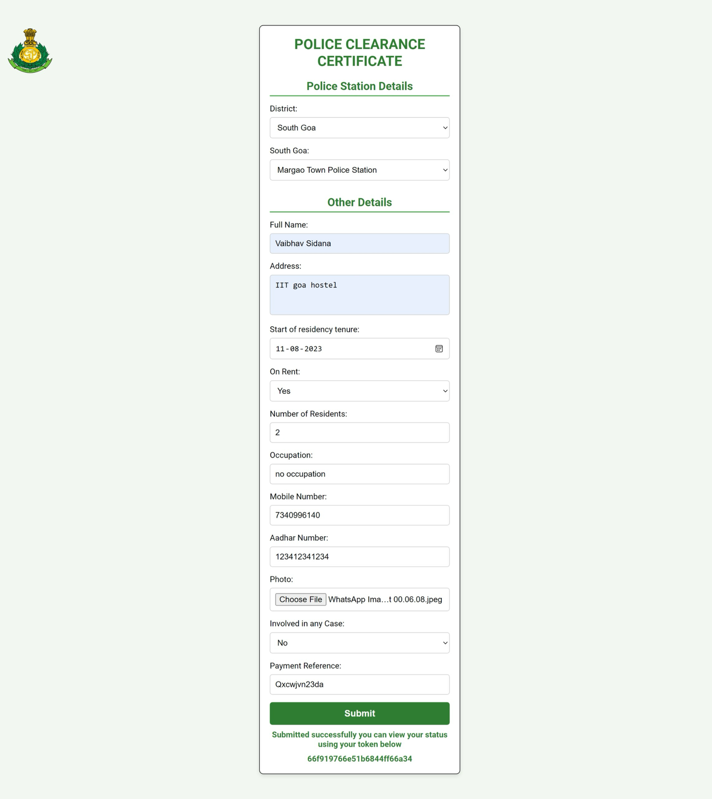
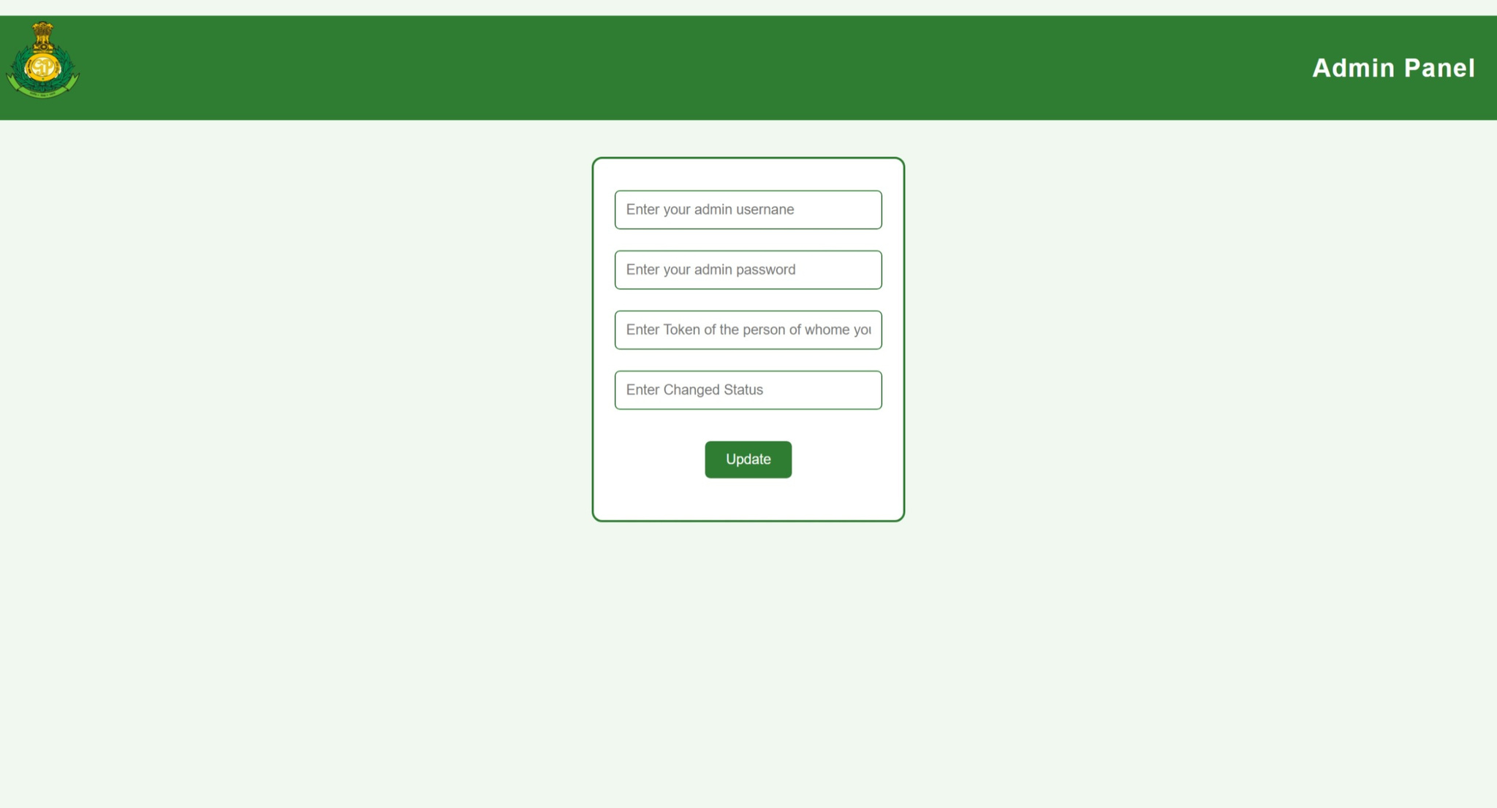
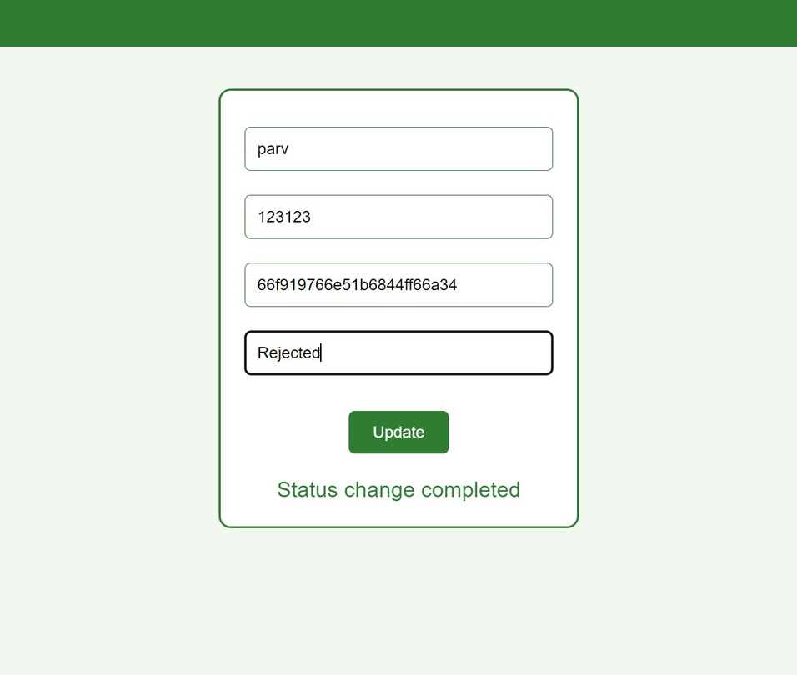
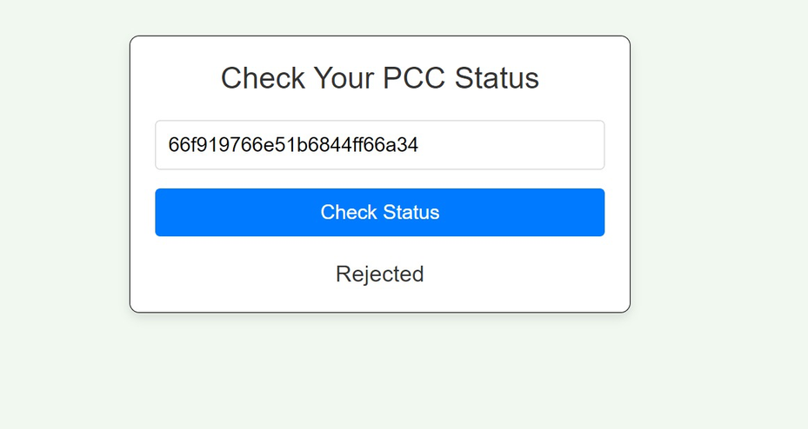
After clicking on "Start a New PCC Application," this form will open, allowing the applicant to enter their personal information and details required for the Police Clearance Certificate application.
Police officers can log in using the "Admin Login" button to verify application details and change the status of PCC applications as needed.
Admin has successfully logged in and updated the status of the PCC application to 'Rejected.' An alert has been displayed stating that the status change is complete.
After clicking the "Review Your Status" button on the homepage, you can check the status of your PCC application by entering the token number provided at the time of submission. If no action has been taken yet, the status will display as "Pending."
After successfully submitting the application, the user will receive a unique token number, which can be used later to check the status of their Police Clearance Certificate application.

Slide 9

COPHELP
Your Trusted Companion for Instant Legal Guidance.
NLP-Based Model: Developed an NLP-powered model for seamless interaction.
Quick Access to Information: Allows visitors to quickly ask general queries that are often needed by citizens.
Emergency Support: Provides immediate responses during urgent situations, enhancing public safety.
Local Assistance: Helps newcomers to the state access vital information like emergency contacts and police station locations.
User-Centric Design: Ensures easy interaction, allowing users to ask questions naturally and receive instant answers.
Enhanced Public Awareness: Empowers citizens with essential information, reducing confusion during emergencies.

Slide 10
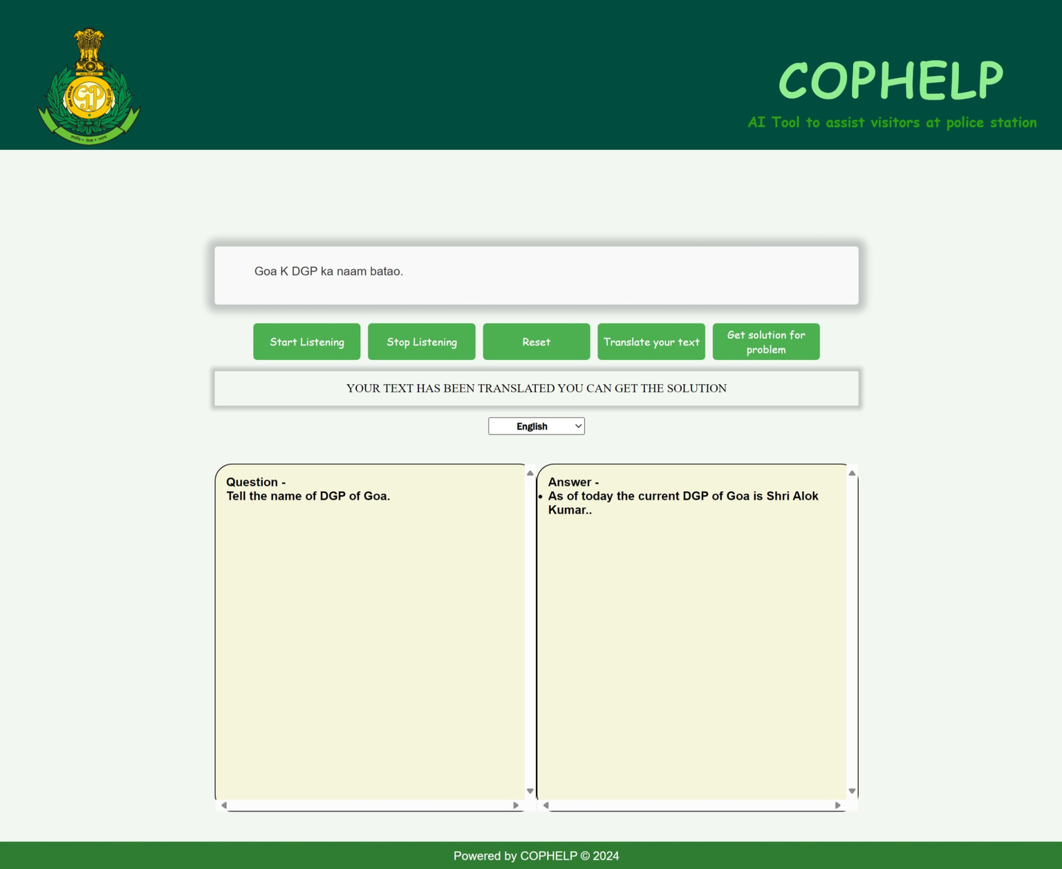
Start Listening: Click to begin recording your issue.
Stop Listening: Click to stop the recording process.
Reset: Click to clear the text box and start fresh.
Translate Your Text: Click to convert your preferred language to English.
Get Solution for Problem: Click to find out the legal procedures to follow for your issue.
This text box displays the user's spoken input after clicking the "Start Listening" button, providing a clear, written record of their issue for easy reference and understanding.
It displays a message indicating that your text has been successfully translated, confirming the completion of the translation process.
This dropdown allows visitors to select their preferred language for receiving legal procedures, ensuring a personalized and accessible experience.
This text box is designated for visitors to submit their questions or queries. Please feel free to type in any inquiries you have, and our chatbot will respond promptly to assist you with the information you need.
This text box contains the answer generated by our tailored specifically to address your query. Our AI model leverages a wealth of information to provide you with accurate and relevant responses, ensuring you receive the assistance you need.

Slide 11
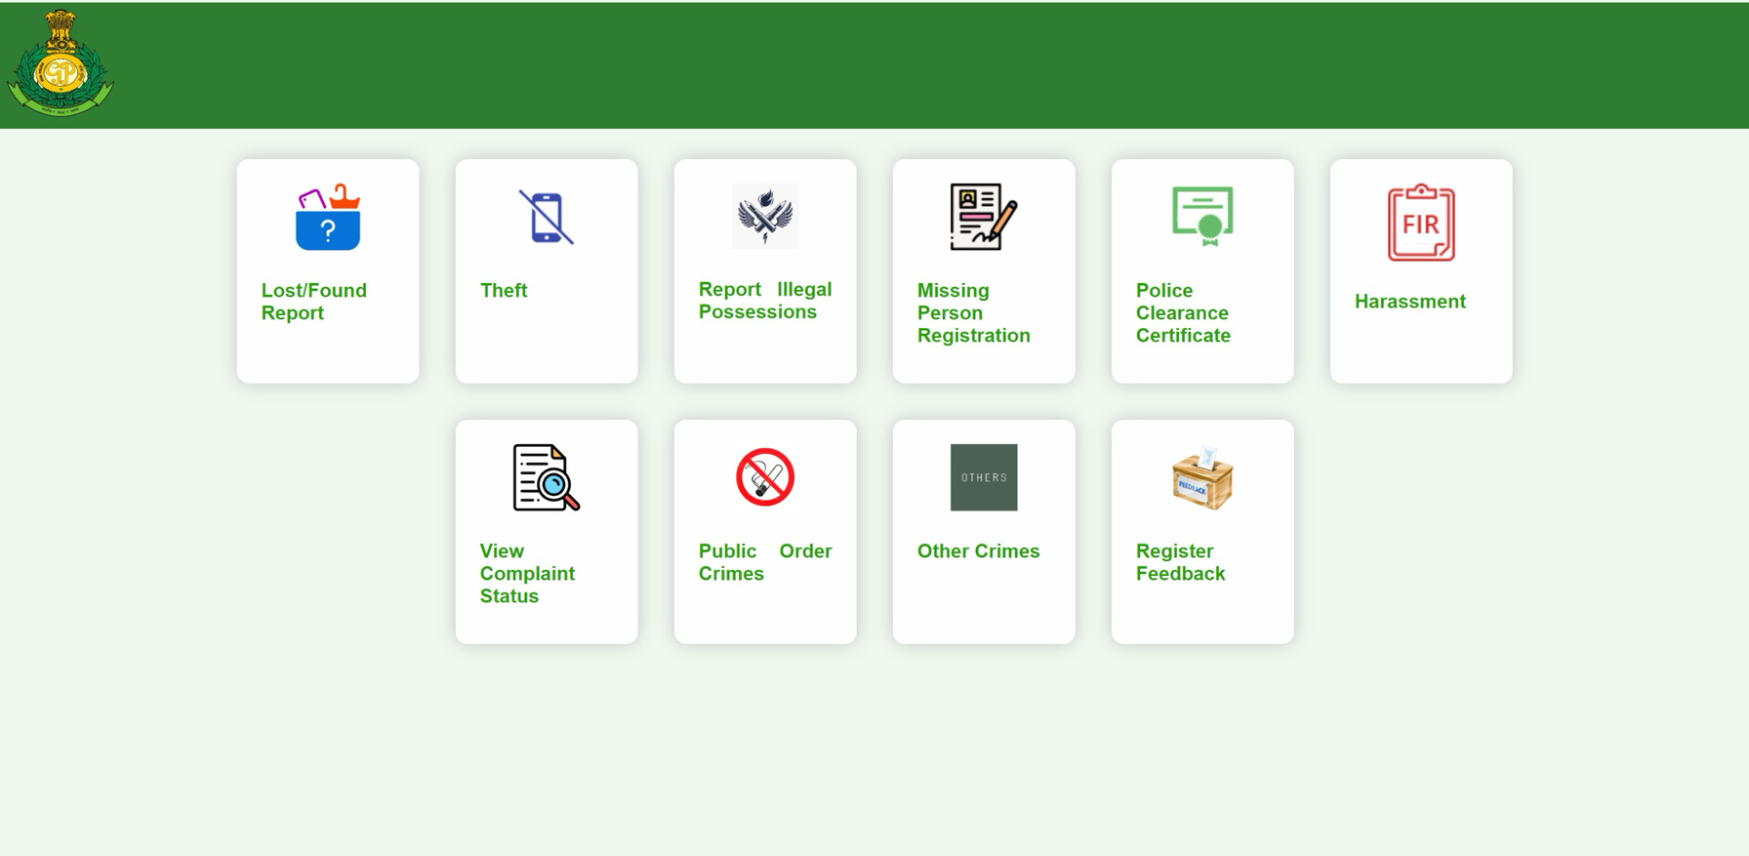
SERVICES
The "Services" Button on the homepage provides visitors with easy access to a list of various crimes for which they can file a case. By clicking this button, users can quickly identify the specific category of their issue, streamlining the reporting process. This feature not only simplifies the task for visitors, allowing them to efficiently navigate their options, but it also enhances the workflow for police officers by organizing case filings. Ultimately, this functionality fosters a more effective communication channel between the public and law enforcement, ensuring that both parties can manage cases more efficiently.

Slide 12
Results & Comparison with Existing Solutions
Lack of Online Translators: No existing online translators are available at police stations, causing communication barriers for out-of-state visitors.
In-Person Queries: Visitors previously needed to visit police stations to inquire about case types and procedures, leading to inconvenience.
Fully Online System: Our solution enables all processes, including case inquiries and submissions, to be completed online, enhancing accessibility.
Online Case Filing: Introduced the ability to file various types of cases online, addressing a significant gap in existing solutions.
Remote PCC Status Checks: Eliminates the need for physical visits to check the status of Police Clearance Certificate applications, allowing users to access this information from anywhere.
Centralized Legal Information: Previously, individuals had to research basic legal information, such as police station locations and emergency contacts; now, all this information is centralized in our chatbot for easy access.

Slide 13
Conclusion
Enhanced Interaction: Developed a user-friendly online platform to improve communication between visitors and police services.
Innovative Tools: Introduced CopBot and CopHelp, utilizing NLP technology for instant access to legal information and guidance.
Streamlined Processes: Transformed traditional in-person procedures into an online format, reducing the need for physical visits.
Addressing Communication Barriers: Facilitated better interactions for out-of-state visitors by providing online translation and legal assistance.
Efficient Case Filing: Implemented a "Services" button for easy identification and filing of various crime cases.
Real-Time Updates: Enabled users to track the status of their Police Clearance Certificate applications remotely.
Empowerment of Citizens: Equipped users with essential information during critical situations, enhancing public safety.
Improved Officer Productivity: Simplified workflows for police officers, allowing them to focus on more complex cases and improving overall efficiency.

